Slide 1

Financial Arbitrage Team The_Five_Stooges Trenten Babcock and Sal Certo
February 2022

Slide 2

The Paper
Finding optimal arbitrage
opportunities using a quantum
Annealer
by Gili Rosenberg
Notes:
Tags: statement, left aligned text, right aligned image, question, image

Slide 3
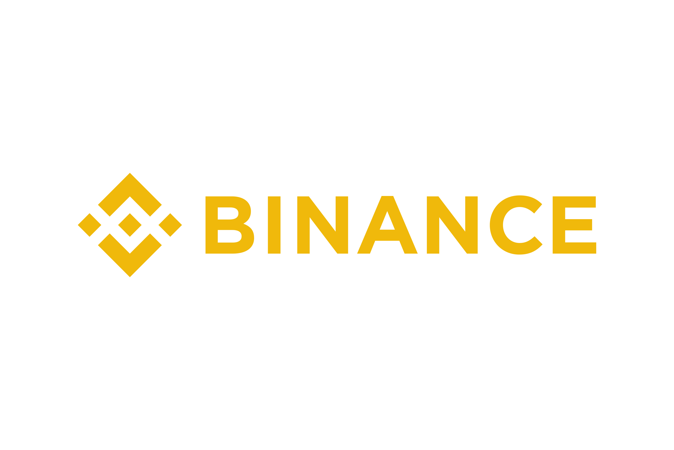

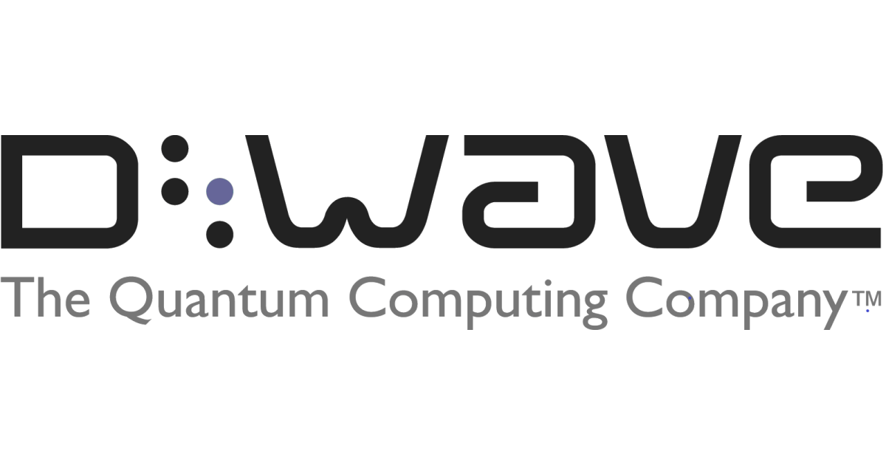
A Hybrid Solution
Background on Quantum Kernels
The Data
We used Python’s Binance Exchange API for the dataset input for this problem.
A pickle file that is serialized with Binance data
The Classical Part
We utilized DOCPLEX as the classical optimizer to maximize the product of conversion rates.
DOCPLEX.model
The Quantum Part
We utilized the following DWAVE Ocean’s methods to sample and convert the data into a QUBO problem.
Dimod
BinaryQuadraticModel
LeapHybridSampler
EmbeddingComposite
Notes:
Scott, 2 minutes
Team Introductions (Scott to introduce team)

Slide 4
Conclusions
Take Away Points
Conclusions:
This Hybrid approach proposed by the white paper has potential to provide faster simulations and higher accuracy in risk and pricing. We’ve constructed an initial framework with DWAVE’s OCEAN SDK for preliminary findings.
Next Steps for Future Research:
Access to DWAVE hardware to run the program
Validation of the results to confirm the theoretical advantages
Notes:
Scott, 2 minutes
Team Introductions (Scott to introduce team)

